Slide 1
CV and RESUME
TUTORIAL - 6

Slide 2
CV
CV stands for Curriculum Vitae or “course of life.” In the US, a CV is a 2–12 page academic document that describes your school career in deep detail.
Curriculum Vitae (CV) is Latin for "course of life." In contrast, resume is French for "summary." Both CVs & Resumes: Are tailored for the specific job/company you are applying to. Should represent you as the best qualified candidate. Are used to get you an interview. Do not usually include personal interests.

Slide 3
Format of a CV
Use 1-inch margins all the way around.
Pick one good CV font and stick with it.
Make your CV as long as you need.
Save your academic CV as a PDF.
List education first, then publication, honors, grants, and conferences.
Add teaching and research experience.

Slide 4
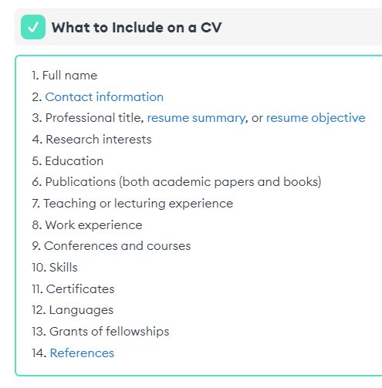

Slide 5
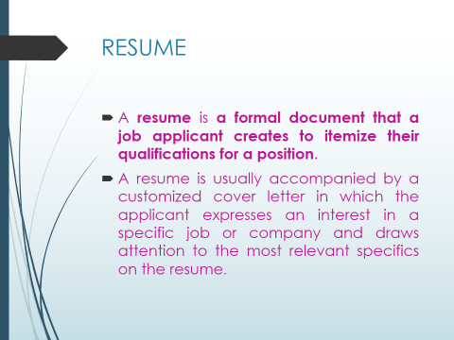

Slide 6
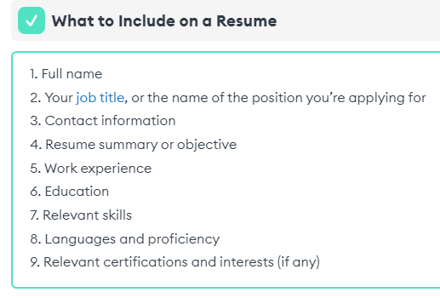

Slide 7
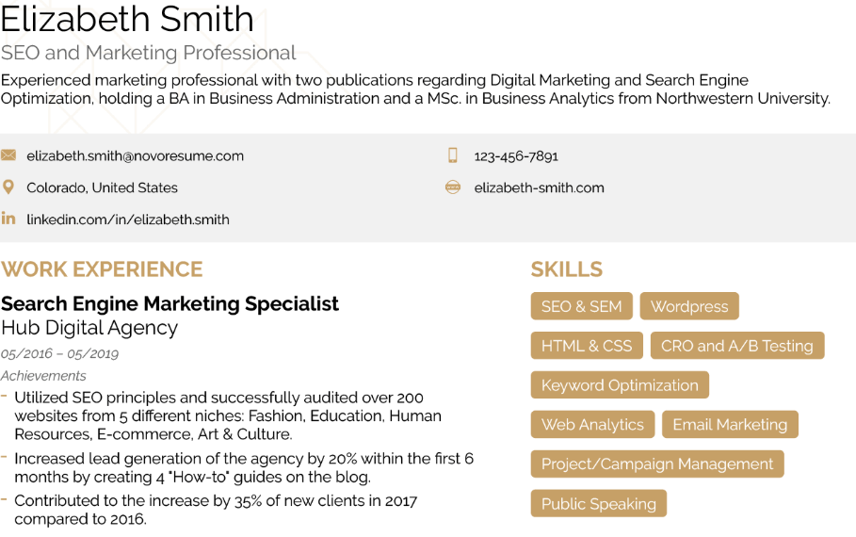

Slide 8
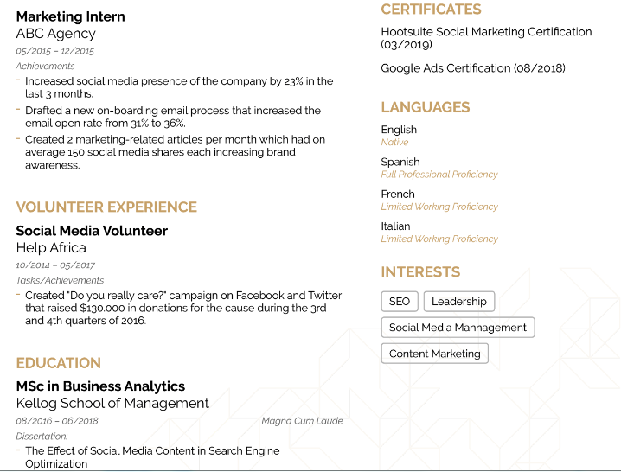

Slide 9
Differences between CV and Resume
Length - The first and most notable difference between a CV and a Resume is how long each one of them is. A resume is kept short and brief (usually 1 page), whereas the CV is more comprehensive (it can go up to 2-3 pages depending on your experience).
Function - The CV is mainly used for academicals purposes, such as applying for a research program, a Ph.D., or joining the staff of a university. The resume, on the other hand, is written for a regular job in a company.
Type of information you include - The CV is an academic diary where you include all your academic qualifications, achievements, and certifications. It is universal in nature as it can be updated as you go. Whereas, a resume has to be created (or at least customized) for each job you’re applying for, and has a bigger focus on your professional achievements, rather than academic.

